Slide 1
The Power of the Lord’s Prayer
Our Father in Heaven, hallowed be Your Name.

Slide 2
Our Father
A Bold Declaration (1 John 3:1)
Father and Son Relationship
Our Father only through Christ

Slide 3
In Heaven, Hallowed Be
God is in the right place
God is worthy of our praise
We must put God in the right place in our lives

Slide 4
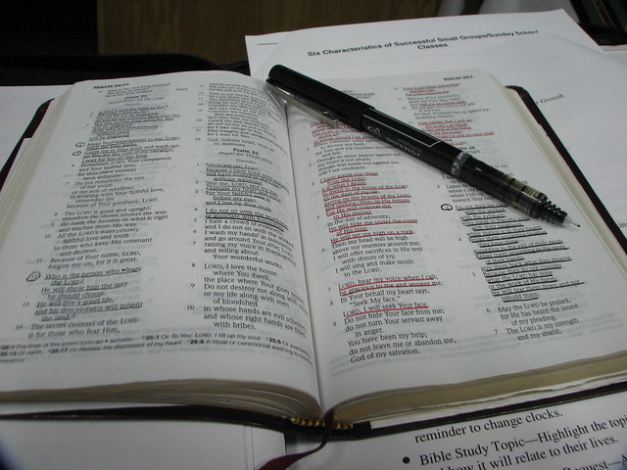
Your Name
Know His Character, not just Name
The Bible shows the Character of God
Christ Shows the Character of God
Do you trust that Character?

Slide 5
Our Father in Heaven, Hallowed be Your Name.
Do you know the Character of God?
Does the God of Heaven dwell in your heart?
Can you call God Father?
Let the power of the Lord’s pray be effective in your life.

